Slide 1
INTRODUCTION TO correlation
Week 4

Slide 2
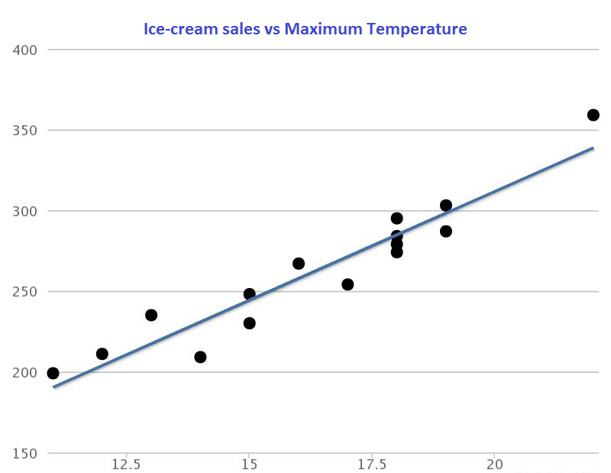
Relationships between variables
Relationships
  how the value of one variable changes when the value of another variable changes
  simple correlation coefficient
Examples:
  Age and strength?
  Income and years of education?
  Memory skills and amount of drug use?
  Your political attitudes and the attitudes of your parents?
Image source: Newcastle University.
Notes:
This shows that there is strong positive linear correlation between ice-cream sales and maximum temperature. However, it is not always as easy to tell just by looking at the scatter graph, instead we quantify it using a numeric value known as the correlation coefficient.

Slide 3
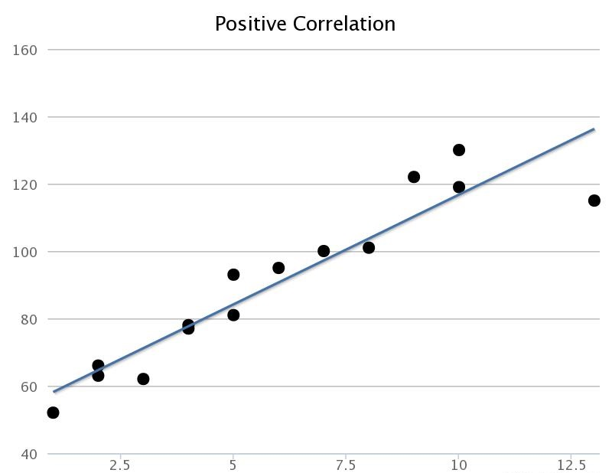
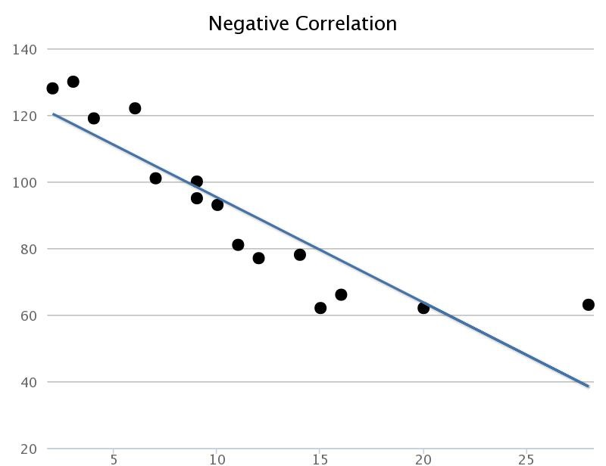
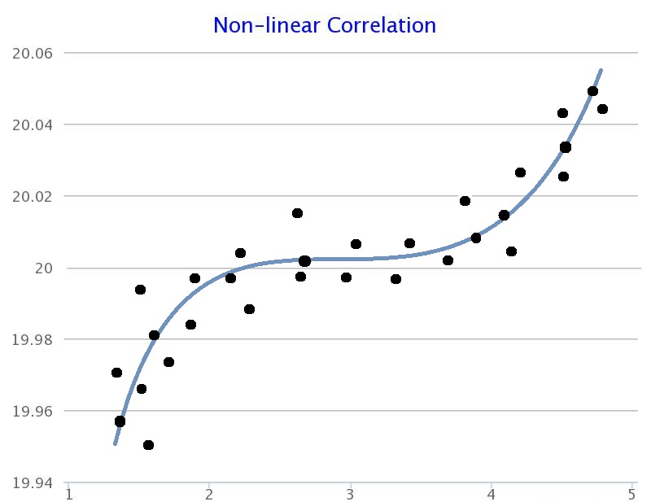
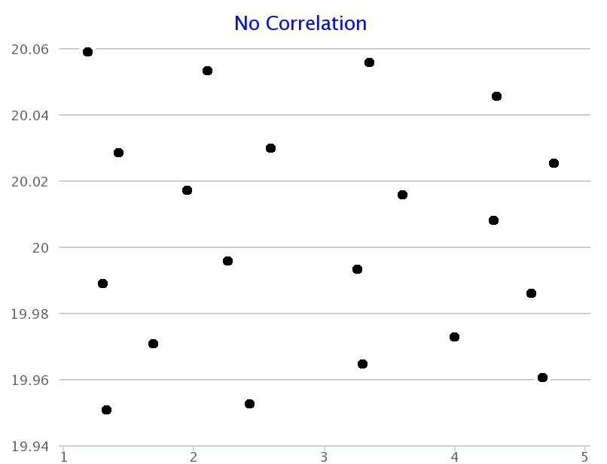
correlation
Purpose:
  a way to measure how associated or related two variables are
Image sources: Newcastle University.

Slide 4
Direction of the Correlation
Positive relationship – Variables change in the same direction.
    As X is increasing, Y is increasing
    As X is decreasing, Y is decreasing
  E.g., As height increases, so does weight.
Negative relationship – Variables change in opposite directions.
    As X is increasing, Y is decreasing
    As X is decreasing, Y is increasing
  E.g., As TV time increases, grades decrease

Slide 5

Worked example
Temperature (°C) | Ice-cream Sales (€)
12.5 | 211
15.8 | 230
22.1 | 359
18.9 | 284
17.7 | 254
19.3 | 287
15.3 | 248
19.2 | 303
13.4 | 235
14.1 | 209
16.7 | 267
18.6 | 295
11.9 | 199
18.4 | 274
18.9 | 279
The local ice-cream shop have kept track of how much ice-cream they sell and the maximum temperature on that day
The data shown is obtained during the last 15 days
Data source: Newcastle University.

Slide 6
Scatter diagram
This shows that there is strong positive linear correlation between ice-cream sales and maximum temperature
However, it is not always as easy to tell just by looking at the scatter graph (subjective)
Instead we quantify it using a numeric value known as the correlation coefficient
The correlation coefficient is a measure of the strength and the direction of a linear relationship between two variables
Image source: Newcastle University.

Slide 7
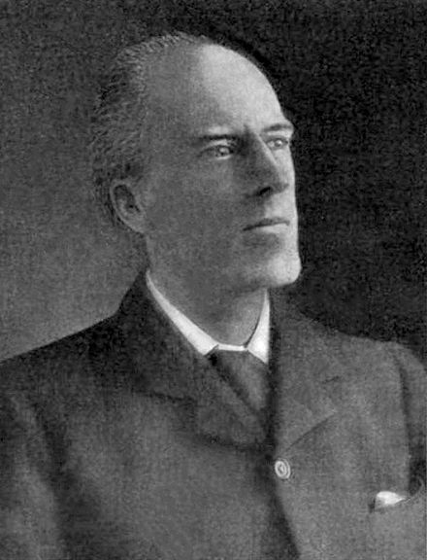
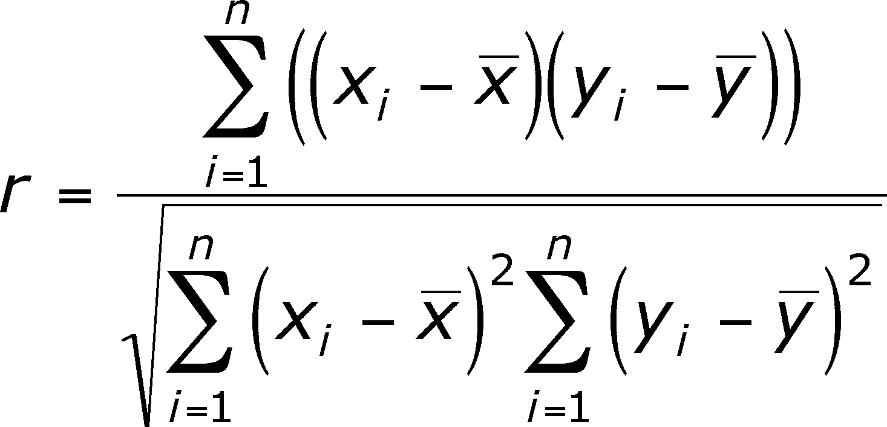
Pearson Correlation coefficient
Professor Carl Pearson.
Image source: Wikipedia.

Slide 8
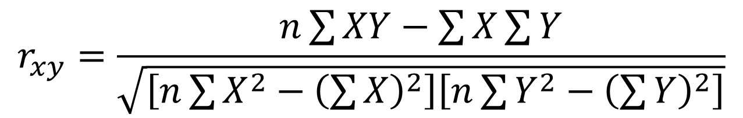
Pearson Correlation coefficient alternative
$$r_{xy}=\frac{n\sum{XY}−\sum{X}\sum{Y}}{\sqrt{\left[n\sum{X^{2}−{\left(\sum{X}\right)}^{2}}\right]\left[n\sum{Y^{2}}−{\left(\sum{Y}\right)}^{2}\right]}}$$
Professor Carl Pearson.
Image source: Wikipedia.

Slide 9
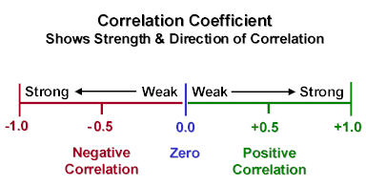
Values of r
Size of the Correlation | Coefficient General Interpretation
.8 to 1.0 | Very strong relationship
.6 to .8 | Strong relationship
.4 to .6 | Moderate relationship
.2 to .4 | Weak relationship
.0 to .2 | Weak or no relationship
“Rule of Thumb” (Salkind & Frey, 2019)

Slide 10
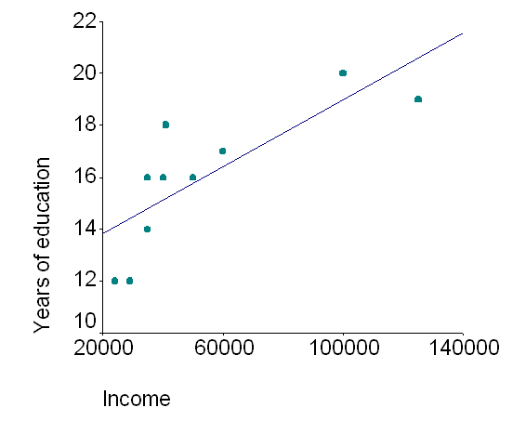
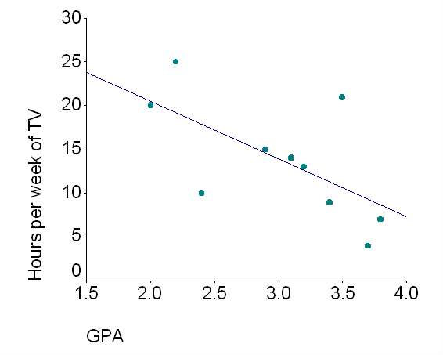
Strength
Correlations, whether positive or negative, range in their strength from weak to strong
In this sample, the correlation is 0.79.
In this sample, the correlation is -0.63.

Slide 11
Compare correlations
Imagine reading four correlational studies with the following scores. You want to decide which study had the strongest results:
  -0.3
  -0.8
  0.4
  0.7
In this example, -0.8 is the strongest correlation
The negative sign means that its direction is negative.
Which is strongest correlation?

Slide 12
Advantage
An advantage of the correlation method is that we can make predictions about things when we know about correlations
If two variables are correlated, we can predict one based on the other
Image source: Newcastle University.

Slide 13
Disadvantage
A correlation tells us that the two variables are related, but we cannot say anything about whether one caused the other
This method does not allow us to come to any conclusions about cause and effect.
Correlation is not Causation!
Image source: Newcastle University.

Slide 14
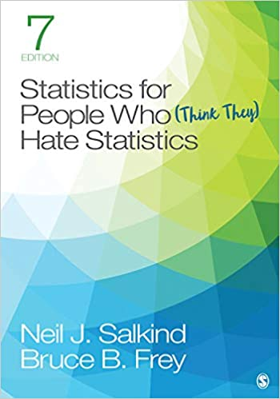
References
Salkind & Frey (2019)
Chapter 5:
  Computing Correlation Coefficients
Image source: Amazon.

